Slide 1

DATABASE
TECHNOLOGIES
Query Processing and Optimization
Suresh Jamadagni
Department of Computer Science
and Engineering

Slide 2

DATABASE TECHNOLOGIES
Query processing and optimization
Suresh Jamadagni
Department of Computer Science and Engineering

Slide 3

DATABASE TECHNOLOGIES
Query Execution – Query Compiler
Algebraic Laws for Improving Query Plans
Commutative Law: x + y = y + x and x × y = y × x
Associative Law: (x + y) + z = x + (y + z); (x × y) × z = x × (y × z)
Several of the operators of relational algebra are both associative and commutative.

Slide 4
DATABASE TECHNOLOGIES
Query Execution – Query Compiler
Laws for Selection
One of the most important rules of efficient query processing is to move the selections down the tree as far as they will go without changing what the expression does
σ_{C1 AND C2} (R) = σ_{C1} (σ_{C2} (R))
σ_{C1 OR C2} (R) = σ_{C1} (R) ∪ σ_{C2} (R)
σ_{C1} (σ_{C2} (R)) = σ_{C2} (σ_{C1} (R))
σ_{C} (R ∪ S) = σ_{C} (R) ∪ σ_{C} (S)
σ_{C} (R − S) = σ_{C} (R) − S
σ_{C} (R − S) = σ_{C} (R) − σ_{C} (S)
σ_{C} (R S) = σ_{C} (R) S
σ_{C} (R _{D} S) = σ_{C} (R) _{D} S
σ_{C} (R ∩ S) = σ_{C} (R) ∩ S.
σ_{C} (R × S) = R × σ_{C} (S)
σ_{C} (R × S) = σ_{C} (R) × S
σ_{C} (R S) = σ_{C} (R) σ_{C} (S)

Slide 5
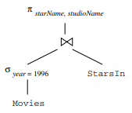
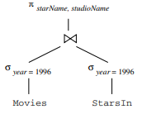
DATABASE TECHNOLOGIES
Query Execution – Query Compiler
Pushing Selection Example
Consider the relations
StarsIn (title, year, starName)
Movies (title, year, length, genre, studioName, producerC#)
CREATE VIEW MoviesOf1996 AS SELECT * FROM Movies WHERE year = 1996;
SQL Query:
SELECT starName, studioName FROM MoviesOf1996 NATURAL JOIN StarsIn;

Slide 6
DATABASE TECHNOLOGIES
Query Execution – Query Compiler
Laws for Projection
π_{L}(R S) = π_{L} (π_{M} (R) π_{N} (S)) where M and N are the join attributes and the input attributes if L that are found among the attributes of R and S, respectively
π_{L}(R _{C} S) = π_{L} (π_{M}(R) _{C} π_{N} (S)) where M and N are the join attributes (i.e., those mentioned in condition C) and the input attributes of L that are found among the attributes of R and S respectively
π_{L}(R × S) = π_{L} (π_{M}(R) × π_{N} (S)) where M and N are the lists of all attributes of R and S, respectively, that are input attributes of L
π_{L}(R ∪ S) = π_{L}(R) ∪ π_{L}(S)
π_{L} (σ_{C} (R)) = π_{L} (σ_{C} (π_{M}(R))) , where M is the list of all attributes that are either input attributes of L or mentioned in condition C.

Slide 7
DATABASE TECHNOLOGIES
Query Execution – Query Compiler
Laws for Joins and Product
R _{C} S = σ_{C} (R × S)
R S = π_{L} (σ_{C} (R × S))
Laws for duplicate elimination
δ(R × S) = δ(R) × δ(S)
δ(R S) = δ(R) δ(S)
δ(R _{C} S) = δ(R) _{C} δ(S)
δ(σ_{C} (R) = σ_{C} (δ(R))

Slide 8
DATABASE TECHNOLOGIES
Query Execution – Query Compiler
Laws for Grouping and Aggregation
δ (γ_{L}(R)) = γ_{L}(R)
γ_{L}(R) = γ_{L} (π_{M}(R))
γ_{L}(R) = γ_{L} (δ(R))

Slide 9
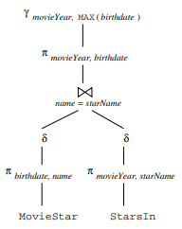
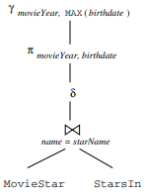
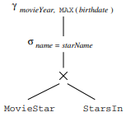
DATABASE TECHNOLOGIES
Query Execution – Query Compiler
Laws for Grouping and Aggregation Example
Consider the relations
MovieStar (name, addr, gender, birthdate)
StarsIn (movieTitle, movieYear, starName)
Query:
SELECT movieYear, MAX(birthdate)
FROM MovieStar, StarsIn
WHERE name = starName
GROUP BY movieYear;

Slide 10
THANK YOU
Suresh Jamadagni
Department of Computer Science and Engineering
sureshjamadagni@pes.edu

